Slide 1
CONTROL SYSTEMS PROJECT DEMONSTRATION
KEY OBJECTIVES OF THE MODEL –
LINE FOLLOWING
OBSTACLE DETECTION AND AVOIDANCE
REDIRECTING PATH

Slide 2
COMPONENTS -
CHASSIS
150RPM BO GEAR MOTOR
IR PROXIMITY SENSORS
ARDUINO UNO
L298N MOTOR DRIVER
BO WHEEL
FF-MM-FM JUMPER WIRES
HC-SR04 ULTRASONIC SENSOR
SG90 SERVO MOTOR

Slide 3
WORKING PRINCIPLE
Line Following
Uses IR sensors (or light sensors) placed at the bottom.
White surface reflects IR light; black surface absorbs it.
Sensors detect whether the robot is on the line (black) or off it (white).
Microcontroller (e.g., Arduino) processes sensor input.
Based on input, it adjusts motor speed/direction (left/right) to keep the robot on track.
Continuous feedback loop ensures the robot follows the line smoothly.
Obstacle Detection and Avoidance
Uses ultrasonic sensor (or IR proximity sensor) to detect obstacles.
The sensor sends ultrasonic waves; reflected waves are received back.
Time taken for echo return is used to calculate distance.
If obstacle distance < threshold, microcontroller takes decision to stop or turn.
Robot changes its path (left/right) or stops completely to avoid collision.
Keeps repeating the process to move safely without hitting obstacles

Slide 4
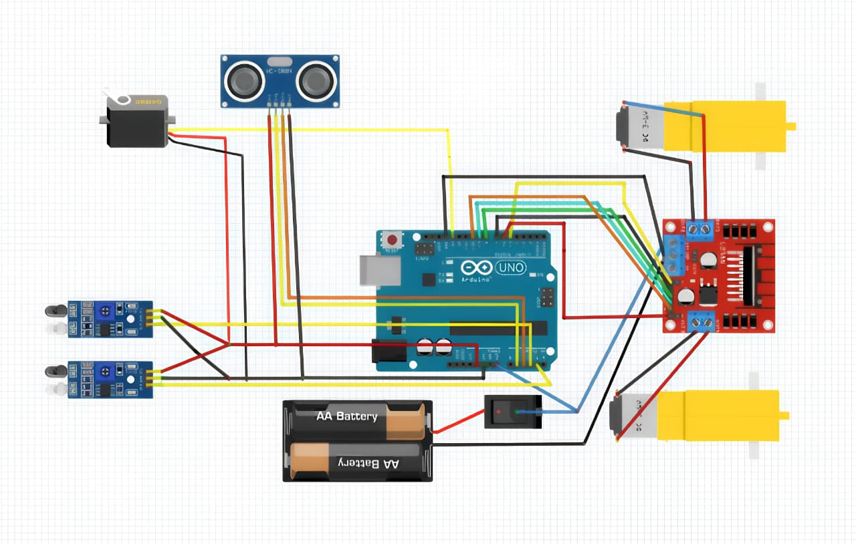
CIRCUIT DIAGRAM -

Slide 5
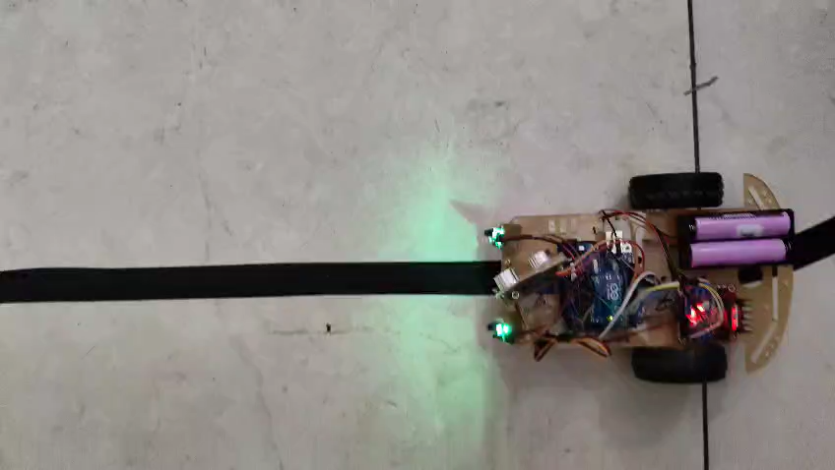
LINE FOLLOWING ATTRIBUTE-

Slide 6
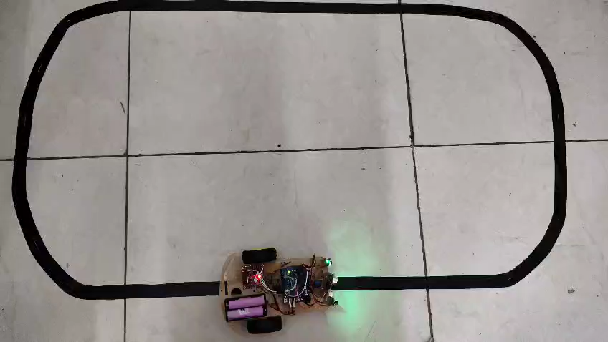

Slide 7
THANK
YOU

